Slide 1
Notes on Swirl
In Swirl Exercises
Ensure you have our course’s swirl exercise – from MachineLearning.swc file
Make sure you pay attention to what you are typing in. At times, I give you the code, but research why the code is the way it is.
Take note - capitalization and spelling matters
No need to upload the files, these are for your benefit.
Some swirl exercises require packages. Have them preinstalled on your RStudio prior to starting the swirl exercise.
For Base_Graphics – you need a package that is part of R – datasets. If a package is part of R, you do not need to pre-install it.
For Loading_Data, You need the ISLR package, which is the package for the book. This package you do need to pre-install.

Slide 2
Basic Concepts and Vocabulary
Chapter 2.1

Slide 3
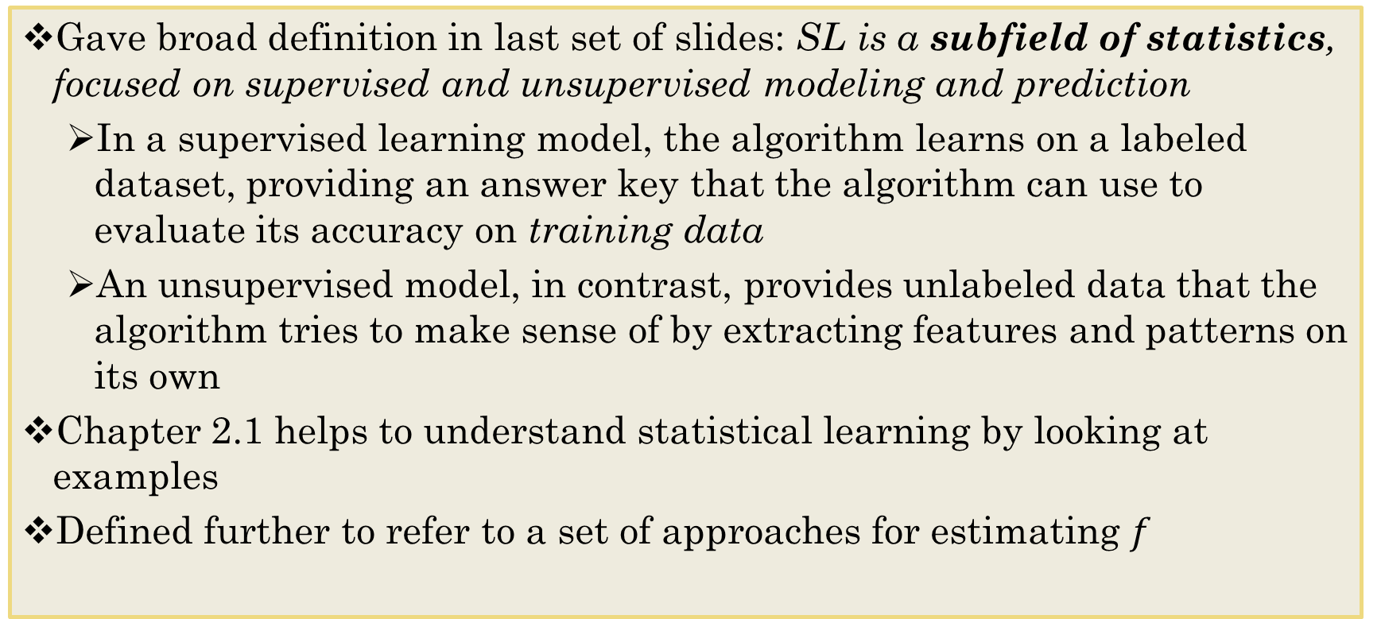
Define Statistical Learning
Gave broad definition in last set of slides: SL is a subfield of statistics, focused on supervised and unsupervised modeling and prediction
In a supervised learning model, the algorithm learns on a labeled dataset, providing an answer key that the algorithm can use to evaluate its accuracy on training data
An unsupervised model, in contrast, provides unlabeled data that the algorithm tries to make sense of by extracting features and patterns on its own
Chapter 2.1 helps to understand statistical learning by looking at examples
Defined further to refer to a set of approaches for estimating $f$
Notes:
The goal for supervised learning is to make prediction on where y is not labelled

Slide 4
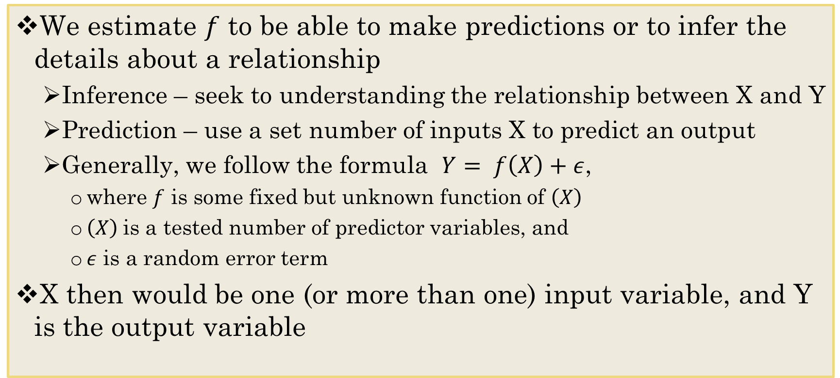
Why estimate $f$?
We estimate $f$ to be able to make predictions or to infer the details about a relationship
Inference – seek to understanding the relationship between X and Y
Prediction – use a set number of inputs X to predict an output
Generally, we follow the formula $Y= f\left(X\right)+ε$,
where $f$ is some fixed but unknown function of $\left(X\right)$
$\left(X\right)$is a tested number of predictor variables, and
$ε$ is a random error term
X then would be one (or more than one) input variable, and Y is the output variable
Notes:
Inference, ie. COVID-19 ~ age, gender,
Prediction: want the x variables that explain the most
Sales of Netflix: age, caching, certain TV shows, how much time spent on Netflix

Slide 5
Input and Output Variables in estimating $f$
Input Variable (X)
Independent Variable
Predictor Variable
Presumed cause of the dependent variable
Covariates
Features
Output Variable (Y)
Dependent Variables
Result variable
Outcome variable
Presumed effect of the independent variable

Slide 6
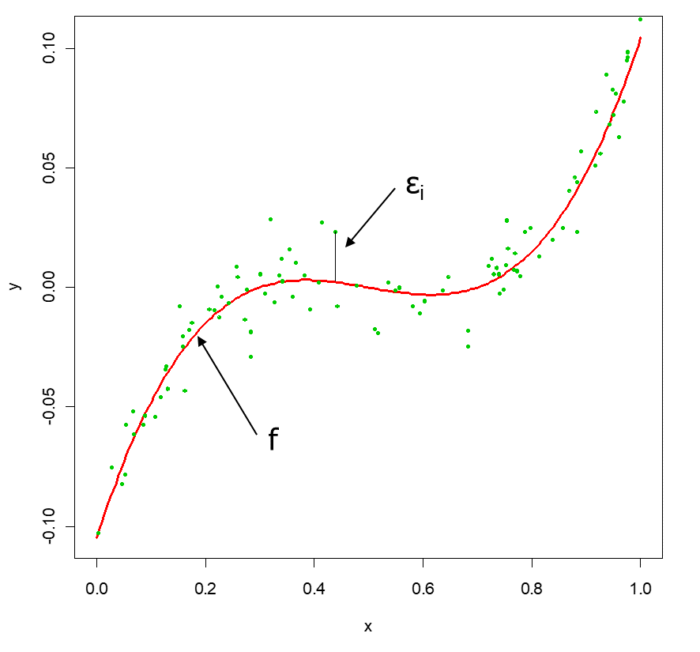
A Simple Example
Notes:
The more spread out the data, the more error

Slide 7
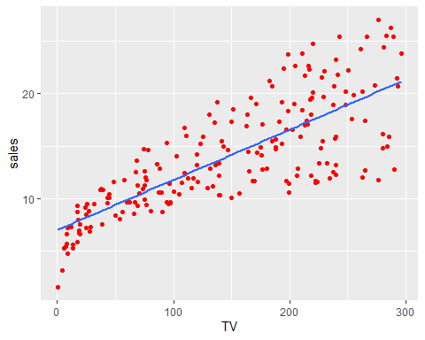
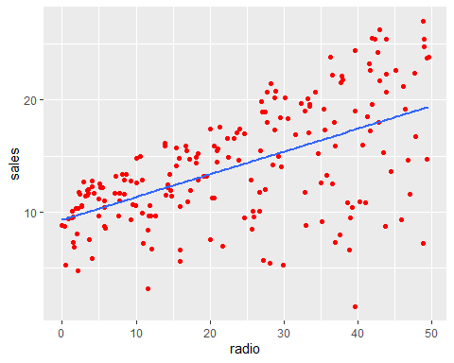
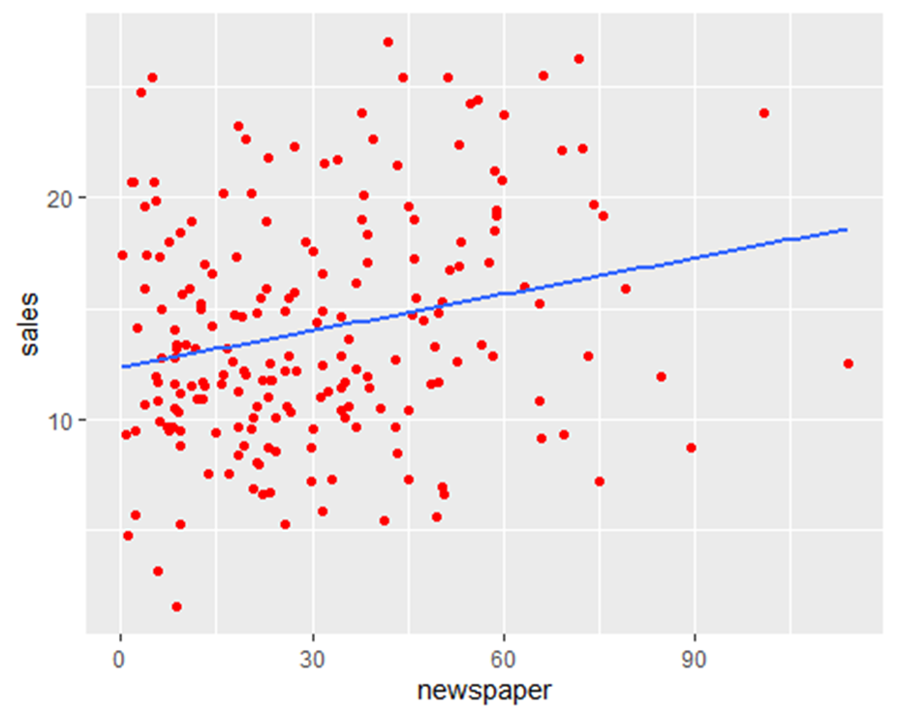
Figure 2.1
ggplot(Advertising, aes(TV, sales)) + geom_point(color="red")+geom_smooth(method="lm", se=FALSE)
ggplot(Advertising, aes(radio, sales)) + geom_point(color="red")+geom_smooth(method="lm", se=FALSE)
ggplot(Advertising, aes(newspaper, sales)) + geom_point(color="red")+geom_smooth(method="lm", se=FALSE)
Notes:
setwd("C:/Users/PSG/Desktop/5072F21/DataSets") ##set your working directory to where you have the data file. My working directory is below. Yours will be different. Advertising <- read.csv("Advertising.csv") ##read in the file - csv's are the easiest to work with. ##make the ggplots mimicking Figure 2.1 in text

Slide 8
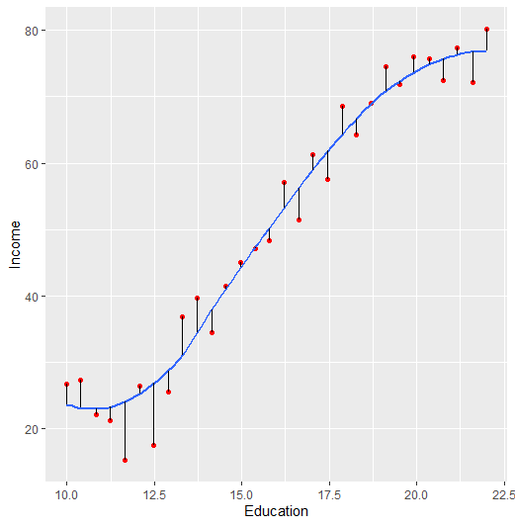
An example from your text
##set your working directory to where you have the data file. My working directory is below. Yours will be different. setwd("C:/Users/PSG/Desktop/5072F21/DataSets") ##read in the file - csv's are the easiest to work with. Income <- read.csv("Income1.csv") ##make a regression. The example in the text used loess regression (a wavy line). regression <- loess(Income ~ Education, data = Income) ##making the fitted dots so that they connect to the regression line. Income <- transform(Income, Fitted = fitted(regression)) ##making the ggplot to mimic the photo in the text labelled Figure 2.2 library(ggplot2) ggplot(Income, aes(Education, Income)) + geom_point(color="red")+geom_smooth(se=FALSE)+geom_segment(aes(x = Education, y = Income, xend = Education, yend = Fitted))
## `geom_smooth()` using method = 'loess' and formula 'y ~ x

Slide 9
Regression vs. Classification Problems in Predictive Analytics
Classification is about predicting a label and regression is about predicting a quantity.
Regression predictive modeling is the task of approximating a mapping function (f) from input variables (X) to a continuous output variable (Y).
Quantitative Variables - Also called numerical variables, discrete variables, and sometimes ratio data
Discrete variable – Integer variables
Count of number of students in class.
Continuous variable – Measurements on a continuum.
Temperature
Distance
Age
Classification predictive modeling is the task of approximating a mapping function (f) from input variables (X) to discrete output variables (Y).
Qualitative Variables - Also called categorical variables, and sometimes grouping variables
Binary variable: yes/no
Game – Win/Lose
Nominal variable: groups with no rank order between them
Brand Names
Notes:
Types of Variables
Handling Categorical Variables
Variable Selection
How many variables and how much selection?
Outliers
Missing Values

Slide 10
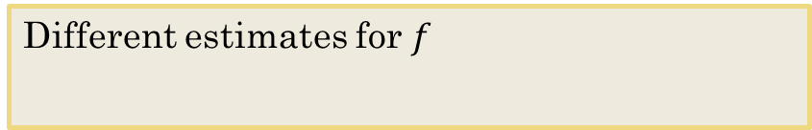
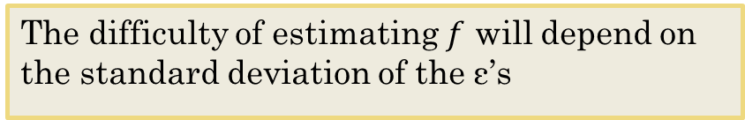
Different Standard Deviations
The difficulty of estimating $f$ will depend on the standard deviation of the ε’s
Different estimates for $f$

Slide 11
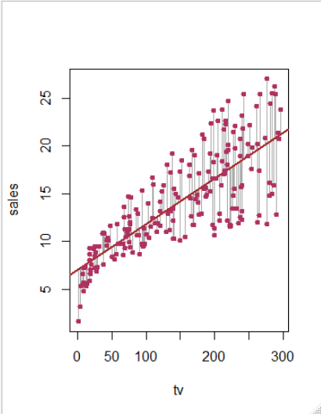
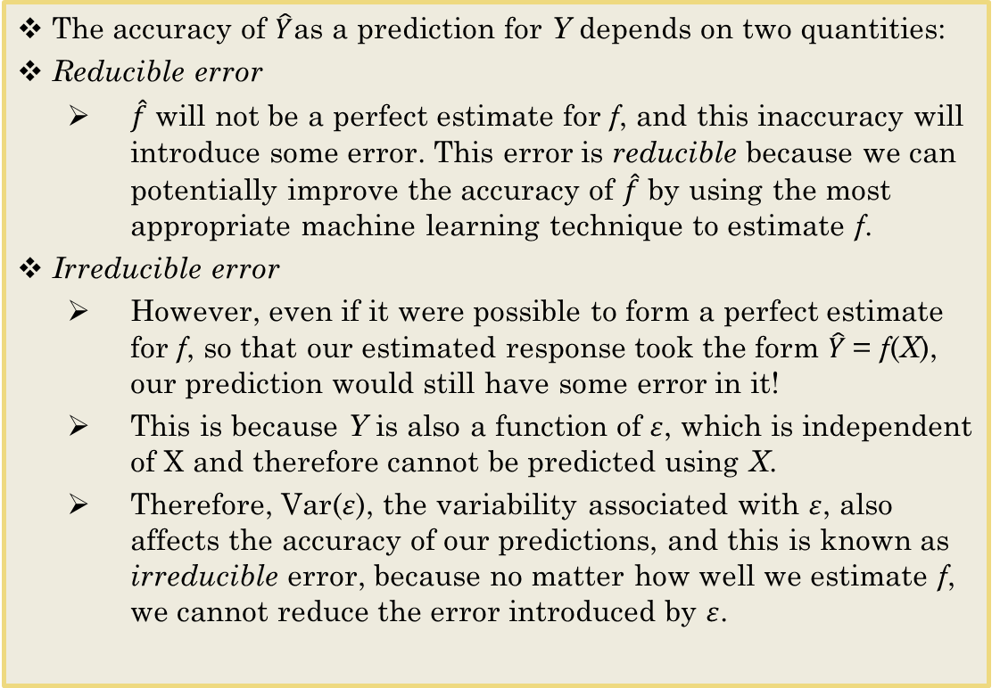
A Little More About Prediction
The accuracy of $\hat{Y}$as a prediction for Y depends on two quantities:
Reducible error
$\hat{\text{f}}$ will not be a perfect estimate for f, and this inaccuracy will introduce some error. This error is reducible because we can potentially improve the accuracy of $\hat{\text{f}}$ by using the most appropriate machine learning technique to estimate f.
Irreducible error
However, even if it were possible to form a perfect estimate for f, so that our estimated response took the form $\hat{Y}$= f(X), our prediction would still have some error in it!
This is because Y is also a function of $ε$, which is independent of X and therefore cannot be predicted using X.
Therefore, Var($ε$), the variability associated with $ε$, also affects the accuracy of our predictions, and this is known as irreducible error, because no matter how well we estimate f, we cannot reduce the error introduced by $ε$.

Slide 12
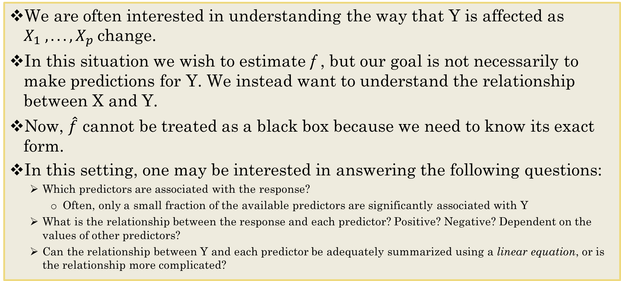
A Little More About Inference
We are often interested in understanding the way that Y is affected as $X_{1} , . . . , X_{p}$change.
In this situation we wish to estimate f , but our goal is not necessarily to make predictions for Y. We instead want to understand the relationship between X and Y.
Now, $\hat{\text{f}}$ cannot be treated as a black box because we need to know its exact form.
In this setting, one may be interested in answering the following questions:
Which predictors are associated with the response?
Often, only a small fraction of the available predictors are significantly associated with Y
What is the relationship between the response and each predictor? Positive? Negative? Dependent on the values of other predictors?
Can the relationship between Y and each predictor be adequately summarized using a linear equation, or is the relationship more complicated?

Slide 13
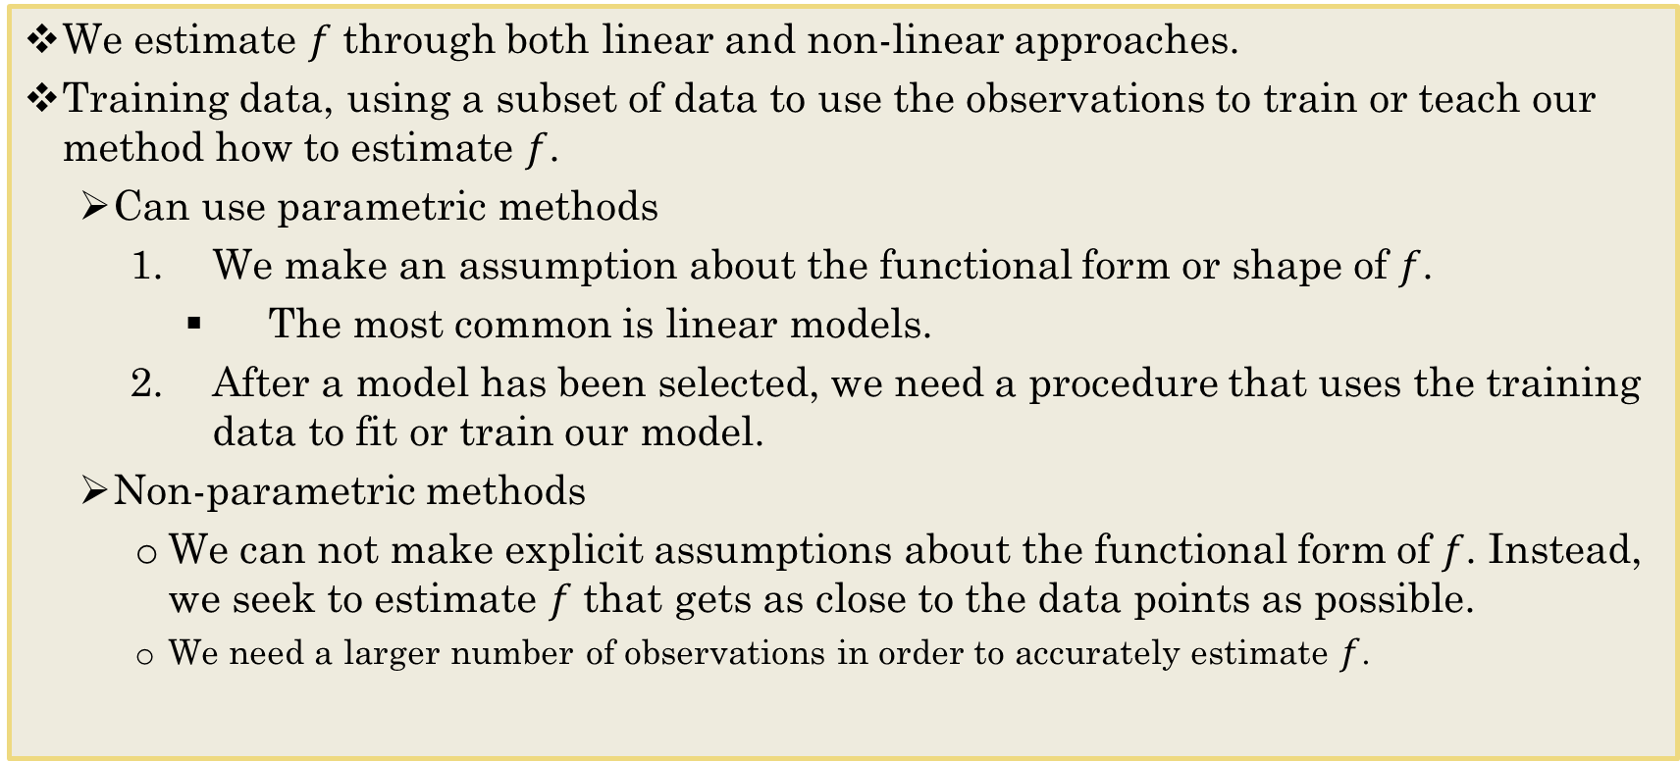
How do we estimate $f$?
We estimate $f$ through both linear and non-linear approaches.
Training data, using a subset of data to use the observations to train or teach our method how to estimate $f$.
Can use parametric methods
We make an assumption about the functional form or shape of $f$.
The most common is linear models.
After a model has been selected, we need a procedure that uses the training data to fit or train our model.
Non-parametric methods
We can not make explicit assumptions about the functional form of $f$. Instead, we seek to estimate $f$ that gets as close to the data points as possible.
We need a larger number of observations in order to accurately estimate $f$.
Notes:
Training set, Test sets (validation sets)
Parametric vs non-parametric

Slide 14
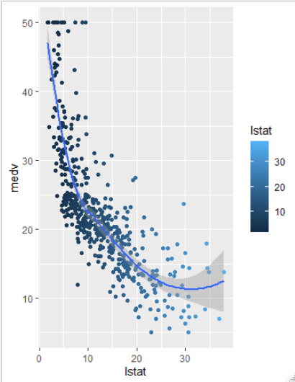
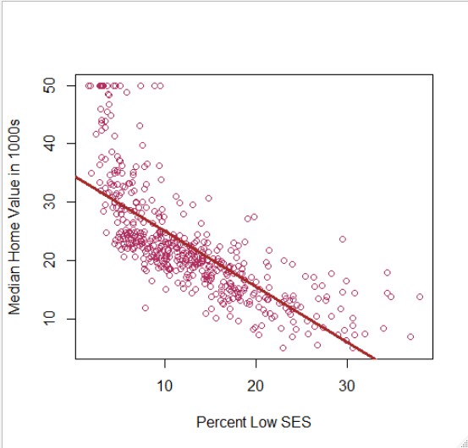
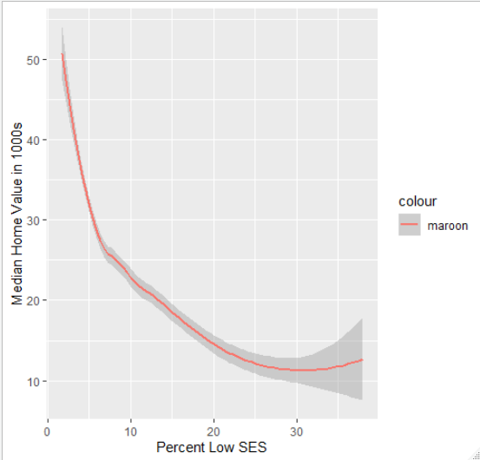
Three Ways to Visualize Home Value and SES

Slide 15
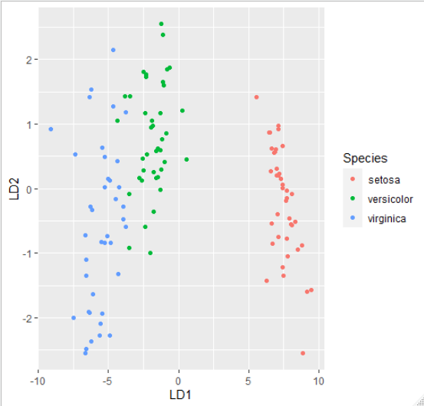
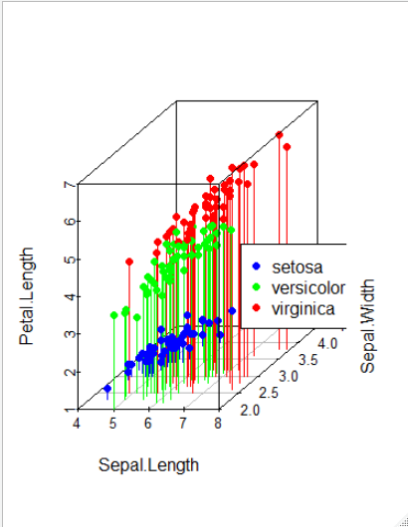
2 Visualizations for Classifying Iris Data

Slide 16
The trade-off between prediction accuracy and model interpretability
Why would we ever choose the use of a more restrictive method instead of a very flexible approach?
Reason 1: Restrictive models are easier to interpret
Reason 2: It is harder to fit a flexible model

Slide 17
Conclusions to Consider
Even if the standard deviation is low we will still get a bad answer if we use the wrong model.
The focus of this course is on techniques for estimating f with the aim of minimizing the reducible error.
It is important to keep in mind that the irreducible error will always provide an upper bound on the accuracy of our prediction for Y.
Notes:
Irreducible error provides the upper bound of the accuracy

Slide 18
Glossary of Terms
Algorithm A specific procedure used to implement a particular ML technique
Confidence concerning the degree of error in an estimate that results from selecting one sample as opposed to another.
Model An algorithm as applied to a dataset, complete with its settings of the parameters that the user can adjust.
Observation The unit of analysis on which the measurements are taken
Prediction The prediction of the numerical value of a continuous output variable; also called estimation.
Predictor A variable, usually denoted by X, used as an input into a predictive model, also called a feature, input variable, independent variable, or from a database perspective, a field.
Response A variable, usually denoted by Y , which is the variable being predicted in supervised learning, also called dependent variable, output variable, target variable, or outcome variable.
Variable Any measurement on the records, including both the input (X) variables and the output (Y ) variable.

Slide 19
For next time
Take some time to research and select topics for Case Study 1.
Work through Base_Graphics to get a sense of what you can do with R.
Take note – I asked you to check out the ggplot2 package.

